Slide 1
HS Series Premium Connections
1
HSM-1 premium connection
2
HSM-2 premium connection
3
HSM-2-HC premium connection
4
HSFJ premium connection
5
HSTS premium connection
6
HSN premium connection
7
HSQR premium connection
8
HSSC premium connection

Slide 2
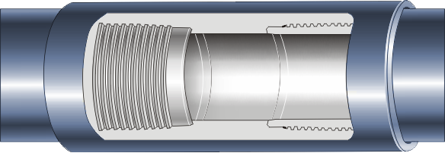
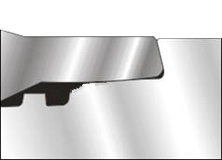
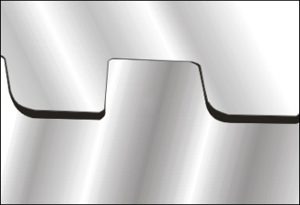
1
HSM-1 premium connection
HSM-1 is the first generation of HYST premium connection products with high performance for the coupling-type NU casing and tubing, which have excellent sealing performance and connection strength. HSM-1 can be applied in complicated working conditions such as deep wells, extra deep wells, high pressure gas wells, etc. Tension efficiency, internal pressure efficiency, and external pressure efficiency can reach 100% of the pipe body, the compression efficiency is 100% of that of the pipe body for tubing and 40% for casing. Special clearance couplings can be supplied upon request. compression
Size range: 2-3/8”～13-3/8”
Steel grades: 55ksi ～150ksi
Improved buttress threads
Cone metal to cone metal seal
Reverse angle torque shoulder
Pipe body
Pipe body
Internal flush design
Coupling
Coupling
Cone seal and shoulder
Thread form

Slide 3
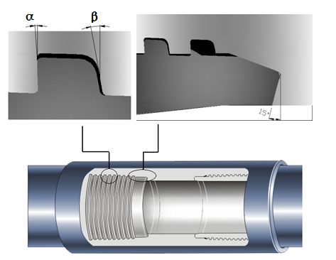
HSM-2 接头
2
HSM-2 premium connection
HSM-2 is the second generation of HYST premium connection products which is coupling-type premium connection with high performance, whose integrity of the structure and sealing performance is maintained under the conditions of harsh and complicated load such as tension, compression, internal pressure, external pressure, bending, etc. HSM-2 can be applied in complicated working conditions such as deep wells, extra deep wells, high temperature and high pressure gas wells, etc. HSM-2 products have validated under ISO 13679:2002 CAL-Ⅳ. Tension efficiency, internal pressure efficiency, and external pressure efficiency can reach 100% of that of the pipe body. The compression efficiency of the tubing is 100% of that of the pipe body, and the compression efficiency of the casing is 60% of that of the pipe body. Special clearance couplings are optional. Product specification: 2-3/8”～16”. Steel grades: 55ksi ～150ksi.
Coupling
Coupling
Hooked threads: Negative angle of load flank
Pipe body
Pipe body
Optimized Cone metal to cone metal seal
Reverse angle torque shoulder
Internal flush design

Slide 4
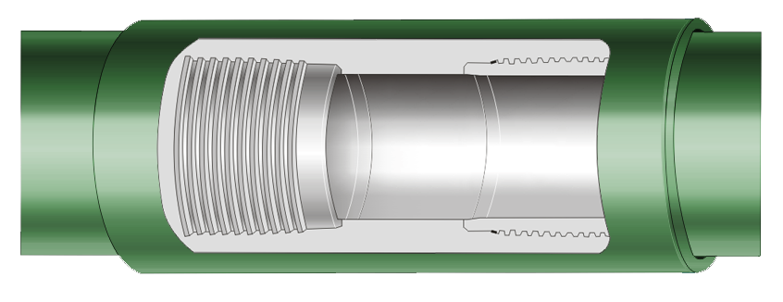
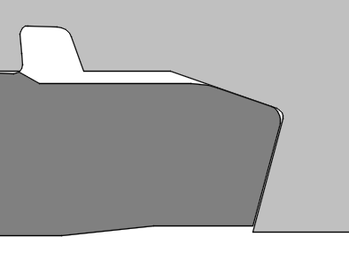
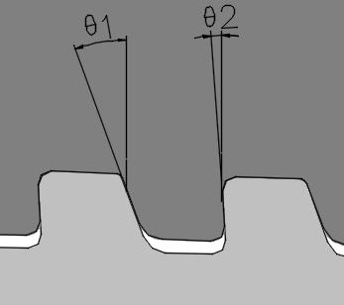
HSM-2接头
HSM-2 接头
3
HSM-2-HC premium connection
HSM-2-HC, is the enhanced type of HSM-2, and the thread type parameters have been further optimized on basis of those of HSM-2, which have excellent compression resistance property and torsion resistance property. HSM-2-HC can be applied in complicated working conditions such as extra deep wells, high temperature and high pressure gas wells, deviated wells, horizontal wells, rotating-required tubular, etc. HSM-2-HC products have validated under ISO 13679:2002 CAL-Ⅳ tests. tension efficiency, internal pressure efficiency, and external pressure efficiency can reach 100% of that of the pipe body. Size range : 2-3/8”～16”. Steel grades: 55ksi ～150ksi.
Optimized hooked with close clearance on the stabbing flank
Optimized cone metal to cone metal seal
Thickened shoulder
Pipe body
Reverse angle torque shoulder
Pipe body
Internal flush design
Coupling
Coupling
Cone seal and shoulder
Thread profile

Slide 5
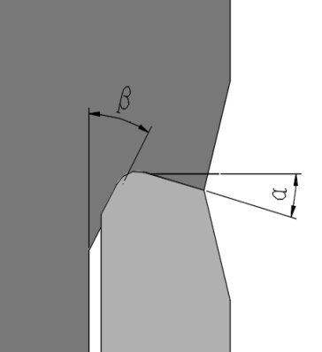

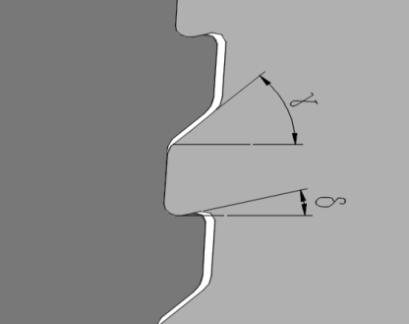
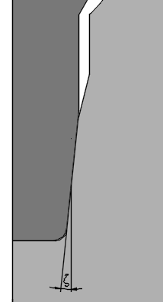
HSFJ
HSM-2 接头
4
HSFJ premium connection
HSFJ is an integral connection with the OD and ID of the connection totally flush with the pipe body. Hooked thread profile has been applied and have double seal structure of cone/cone which are located inside and outside respectively ,The maximum annular clearance can be provided for wellbore, which is suitable for the environment having special requirements of annular clearance and joint strength. The tension efficiency can reach 60% of that of the pipe body, the internal pressure efficiency, and external pressure efficiency can reach 100% of that of the pipe body. The compression efficiency shall be 40% of that of the pipe body.
Product specification: 2-7/8”～11-3/4”. Steel grades: 55ksi ～150ksi.
Double seal structure of cone/cone
External seal and shoulder
Double shoulder for inside and outside guarantee the accurate position for make-up and torsion resistance property
Thread profile
Hooked thread
Internal seal and shoulder
Flush design for Internal and external

Slide 6

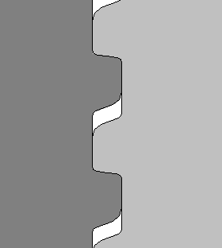
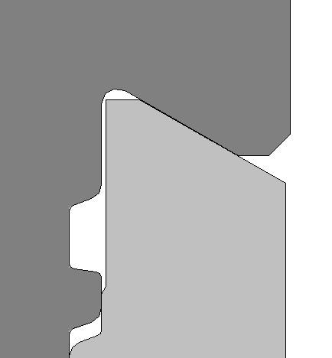
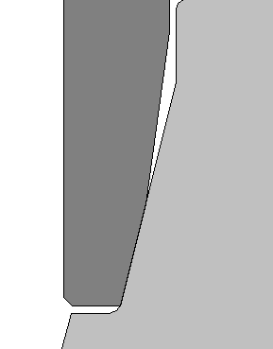
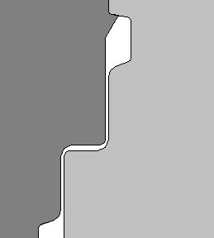
HSM-2 接头
HSTS
5
HSTS premium connection
HSTS, the integral joint of the upsetting end, with the design of two-stage interference-free cylindrical thread, have excellent anti-galling performance and sealing performance, which can be applied in working tubular and producing tubular, and suitable for the harsh working environment such as deep wells, high pressure wells, horizontal wells, acidic gas wells, etc. The tension efficiency, internal pressure efficiency, and external pressure efficiency can reach 100% of that of the pipe body. The compression efficiency shall be 40% of that of the pipe body. Product specification: 2-3/8”～4-1/2”. Steel grades: 55ksi ～150ksi.
Two-stage interference-free cylindrical thread
Two-stage buttress cylindrical thread
Outside shoulder
Triple shoulder structure of outside, intermediate, and inside
Cone / Cone metal seal structure
Flush design for Internal and external
Inside sealing surface and shoulder
Intermediate shoulder

Slide 7

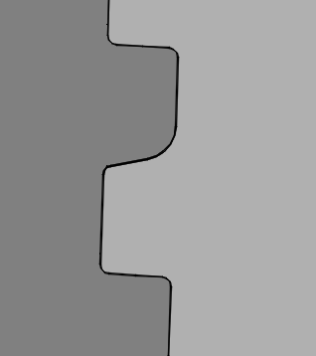
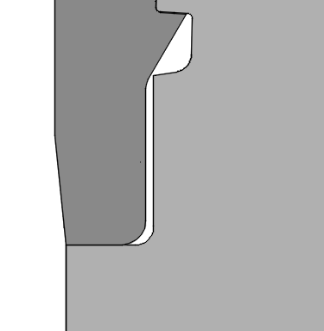
HSN
HSM-2 接头
6
HSN premium connection
HSN is an improved connection based on API buttress thread, has excellent torsion resistance, bending resistance and anti-compression properties, which is interchangeable with API buttress thread. Torsion resistance casing connection is suitable for the well having special requirements for the torsion and compression, e.g. improve the quality of liner cementation by rotating the liner tubular. HSN products can be applied in deep wells, deviated wells, horizontal wells, thermal production wells. Joint efficiency is 100% of that of the pipe body. Product specification: 4-1/2”～13-3/8”. Steel grades: 55ksi ～150ksi.
Thread profile
API Buttress thread
Shoulder design for torsion resistance
Interchangeable with API buttress thread
shoulder
Internal flush design

Slide 8
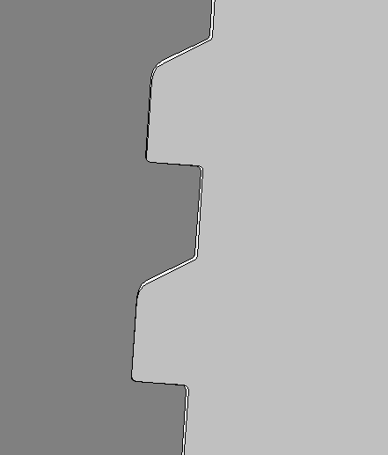
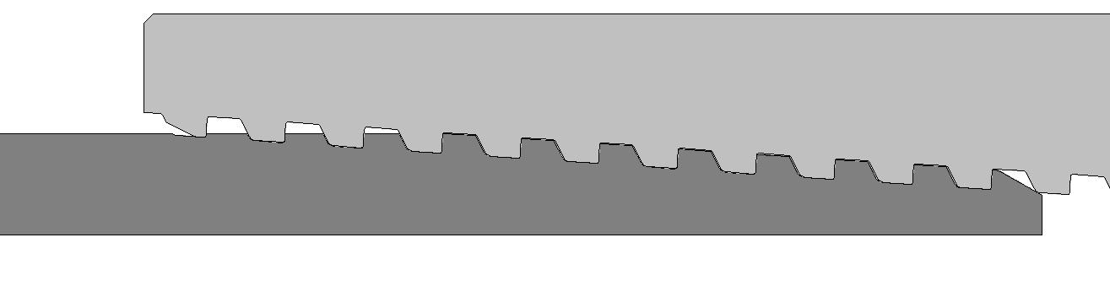
HSKS
HSM-2 接头
7
HSQR premium connection
HSQR is the improved buttress thread connection, which has the bigger thread pitch of 3 tooth per inch and can be applied in casings with large diameters. HSQR is a quick running connection with easy to stabbing and make up. The joint efficiency is 100% of that of the pipe body. Product specification: 13-3/8”～20”. Steel grades: 55ksi ～150ksi.
Improved buttress thread with the large angle stab flank
Design of large taper and bigger thread pitch
Design of optimized couplings
Thread profile

Slide 9
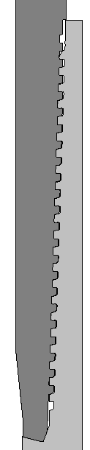

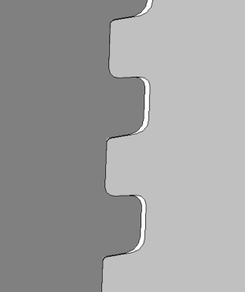
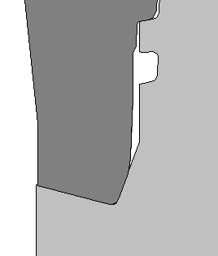
全尺寸实验室
HSM-2 接头
8
HSSC premium connection
HSSC is the coupling-type premium connection with high properties for special clearance couplings, which can provide the maximum annular clearance and suitable for the environment having special requirements for annular clearance and joint strength. HSSC can be applied in complicated working conditions such as deep wells, extra deep wells, high temperature and high pressure gas wells, etc. The tension efficiency can reach 80% of that of the pipe body, external pressure efficiency 100% of that of the pipe body, internal pressure efficiency 80% of that of the pipe body, and the compression efficiency 60% of that of the pipe body. Product specification: 5”～14”. Steel grades: 55ksi ～150ksi.
Design for slim coupling
Hooked thread profile with negative load flank
Optimized cone / cone metal seal
Vanishing end of the thread engagement
Reverse angle torque shoulder
Thread profile
Internal flush design
Sealing surface and shoulder

